Slide 1
Linux File Systems Part 1
Panther Linux User Group
By: Michael Tracy & Alwyn Malachi Berkeley

Slide 2
What is a File System?
What is a File? Abstraction consisting of 0s and 1s
A method for storing, manipulating, and retrieval computer files
Think of it as a database for storage mediums

Slide 3
How a Unix FS works
Files are represented by inodes
Inodes denote the blocks allocated to a file
A folder is simply a reference to inode numbers
Files are just inodes

Slide 4
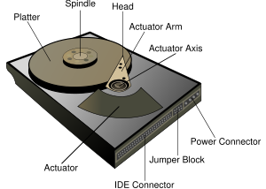
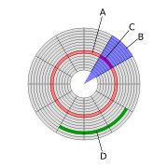
Diagram
Taken from Wikipedia (http://en.wikipedia.org/wiki/Hard_disk_drive)

Slide 5
Now We Can Talk About FS
Organize clusters/blocks
Saves file information in FAT & inode
Only the basics
You can secure basic operations through ACL or Capabilities
Different types for different media
Journaling, versioning, log-structured, database, transactional, network, special purpose

Slide 6
Ext2
'The Second Extended filesystem'
Successor to Ext1 and MinixFS
Features:
  Files are referenced by inodes
  No journal
  Rock solid—FS of choice for small installations

Slide 7
Ext3
'Third extended filesystem'
Features:
  Journal
  Larger file limits than ext2
Criticism
  No online defrag
  No dynamic inode allocation

Slide 8
Ext4
'Fourth extended filesystem'
Features:
  Larger limits and better performance over Ext3
  Extents
Criticism:
  Write through hole

Slide 9
ReiserFS 3
Circular log
1. remove entry, delete data
Hans Reiser
Files under 4 kilobytes
Defragmentation
Online resizing, growth only
Big Kernel Lock, scaling on multicore
Fsck could destroy internal files
Didn't use a O(N) to find files like ext 2

Slide 10
ReiserFS 4
Defragmenting ability
Tailpacking, hit performance
Encryption support
Faster handling of directories /w many files

Slide 11
New Filesystems

Slide 12
Tux 3
Daniel Phillip
Zumastor NAS project
Snapshots & Remote Replication

Slide 13
Server Filesystems

Slide 14
XFS/JFS
The original journaling filesystems for Linux
Very fast for large files and very large partitions
Features:
  Extents
  Dynamic allocation
  Striping of files

Slide 15
ZFS
See Wikipedia...

Slide 16
BtrFS (“Butter FS”)
Dynamic inode Allocation
Online utilities for resizing etc.
Snapshots
Many similarities to zfs

Slide 17
Flash File Systems
Disk file systems are not optimal on flash drives (Erase blocks first, random access(seeks), writes distributed)

Slide 18
JFFS2
UNDER CONSTRUCTION

Slide 19
SquashFS
Embedded systems

Slide 20
Network Filesystems

Slide 21
SMBFS/CIFS
Windows Shares

Slide 22
ProcFS
If the kernel was a person, this is what the person would be thinking

